Slide 1
Лондон и Париж: храмы
Глушкова Анастасия

Slide 2
Table of contents
Churches of London:
St Paul's Cathedral (pictures)
Westminster Abbey (pictures)
Westminster Cathedral (pictures)
Churches of Paris:
Cathédrale Notre-Dame de Paris (pictures)
Basilique du Sacré-Cœur (pictures)
Sainte-Chapelle (pictures)
Comparing English and French churches:
The Gothic Churches (pictures)
Gothic and Roman style in one (pictures)
Different from all

Slide 3
St Paul's Cathedral
St Paul's Cathedral is the Anglican cathedral on Ludgate Hill, in the City of London, and the seat of the Bishop of London.
The present building dates from the 17th century and is generally reckoned to be London's fifth St Paul's Cathedral, although the number is higher if every major medieval reconstruction is counted as a new cathedral.
The cathedral sits on the edge of London's oldest region, the City, which originated as a Roman trading post along the edge of the River Thames.
The cathedral is one of London's most visited sites.

Slide 4
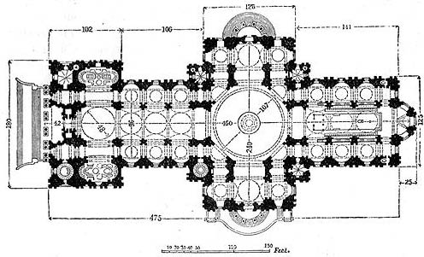
St Paul's Cathedral
An aerial view of St Paul’s Cathedral.
Plan.
360° view near the High Altar at St Paul’s Cathedral.

Slide 5
Westminster Abbey
The Collegiate Church of St Peter at Westminster, which is almost always referred to by its original name of Westminster Abbey, is a large, mainly Gothic church, in Westminster, London, just to the west of the Palace of Westminster.
It is the traditional place of coronation and burial site for English and later British monarchs.
It briefly held the status of a cathedral from 1546–1556, and is currently a Royal Peculiar.

Slide 6
Westminster Abbey
The Great West Door and towers
The North entrance

Slide 7
Westminster Cathedral
Westminster Cathedral in London, is the mother church of the Roman Catholic community in England and Wales and the Metropolitan Church and Cathedral of the Archbishop of Westminster.
The cathedral is located in Victoria, in the City of Westminster. It is the largest Roman Catholic church in England and Wales, and should not be confused with Westminster Abbey of the Church of England, Westminster Cathedral is the seat of the Archbishop of Westminster, currently Cormac Cardinal Murphy-O'Connor, shepherd of the Archdiocese of Westminster. As a matter of custom each newly appointed Archbishop of Westminster has been created a cardinal in consistory.

Slide 8
Westminster Cathedral
The interior of Westminster Cathedral
Westminster Cathedral from Victoria Street

Slide 9
Cathédrale Notre-Dame de Paris
Notre-Dame de Paris, est la cathédrale de l'archidiocèse catholique de Paris.
Notre-Dame de Paris n'est pas la plus grande des cathédrales françaises, mais elle est indiscutablement l'une des plus remarquables qu'ait produites l'architecture gothique en France et en Europe.
Ce chef-d’œuvre, l’un des symboles les plus connus de la capitale française, est situé à l’extrémité est de l’île de la Cité, centre historique de la ville, tout près des berges de la Seine.

Slide 10
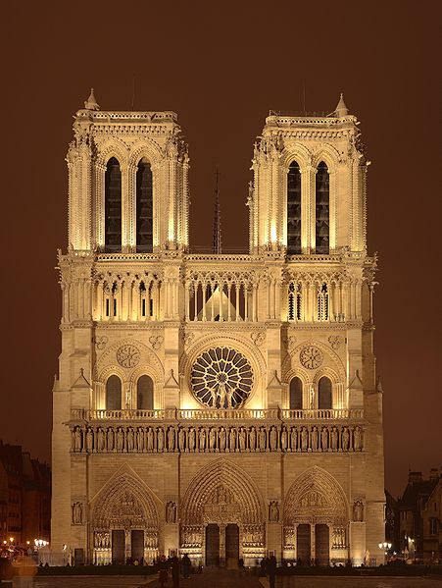
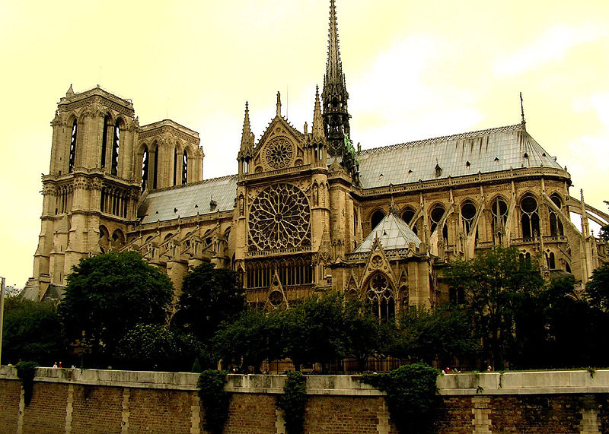
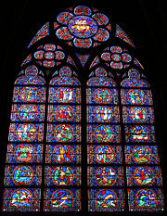
Cathédrale Notre-Dame de Paris
Un vitrail de Notre-Dame

Slide 11
Basilique du Sacré-Cœur de Montmartre
La basilique du Sacré-Cœur est un édifice religieux parisien majeur situé sur la butte Montmartre.
Avec plus de 10 millions de pèlerins et visiteurs par an (2006), c'est le second monument de France le plus visité après la Cathédrale Notre-Dame de Paris.
La basilique est en forme de croix grecque, ornée de quatre coupoles.

Slide 12
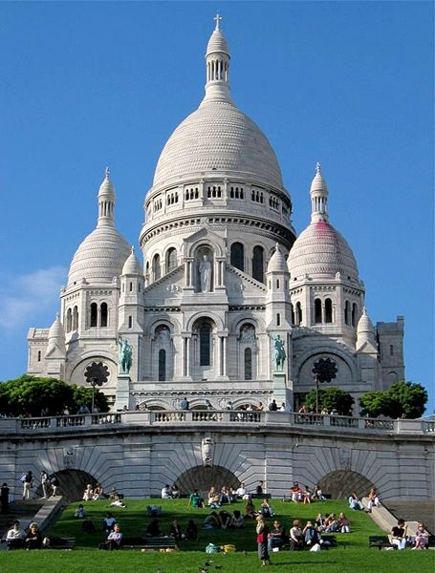
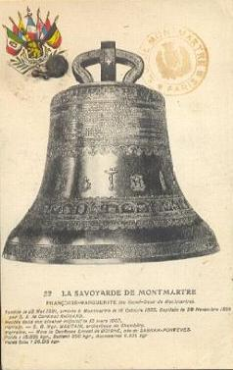
Basilique du Sacré-Cœur
Cloche la Savoyarde

Slide 13
Sainte-Chapelle
La Sainte-Chapelle fut édifiée sur l'île de la Cité, à Paris, à la demande de Saint-Louis afin d'abriter la Sainte couronne, un morceau de la Sainte Croix ainsi que diverses autres reliques qu'il avait acquises.
Avec la Conciergerie, c'est l'un des anciens vestiges du Palais de la Cité qui s'étendait sur le site couvrant l'actuel Palais de justice de Paris.
La Sainte Chapelle est gérée par le Centre des monuments nationaux à qui elle a été attribuée à titre de dotation par un arrêté du 2 avril 2008.
En moyenne, quelque 800 000 visiteurs de 46 nationalités différentes visitent chaque année ce joyau du gothique rayonnant.

Slide 14
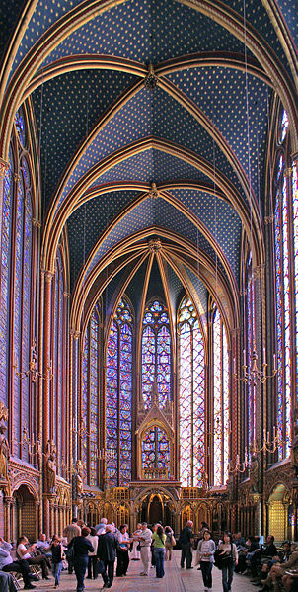
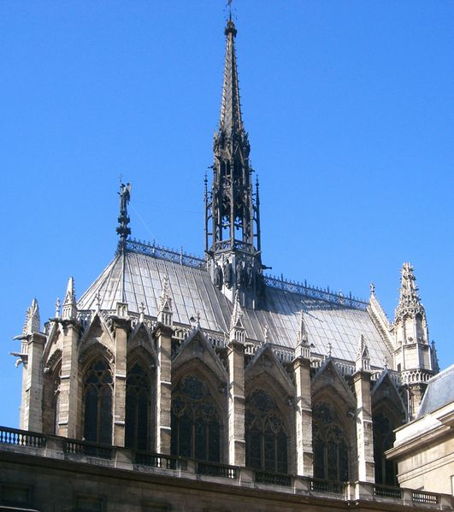
Sainte-Chapelle
La Sainte-Chapelle vue du Palais de Justice
Chapelle haute

Slide 15
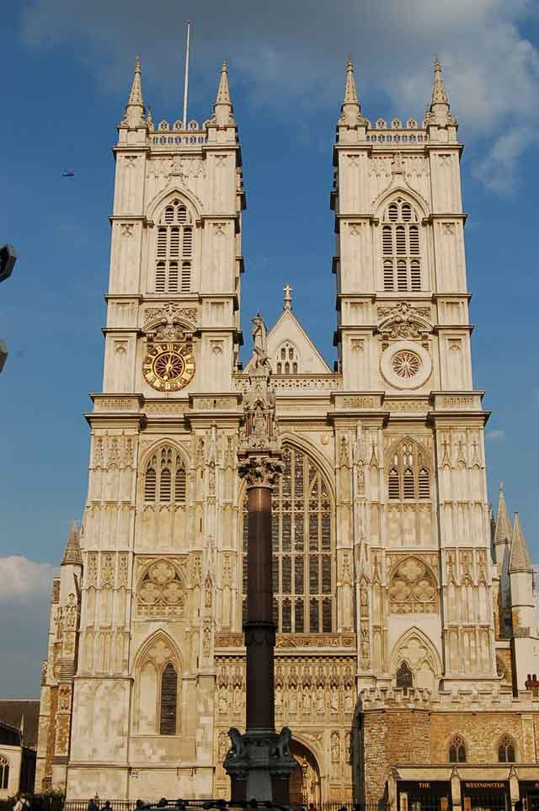
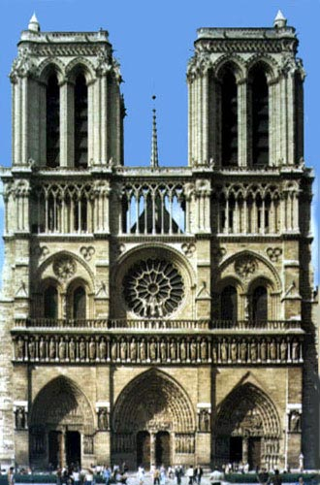
The Gothic Churches (western facades)
Westminster Abbey
Cathédrale Notre-Dame de Paris

Slide 16
The Gothic Churches (south facades)
Westminster Abbey
Cathédrale Notre-Dame de Paris

Slide 17
The Gothic Churches
Was being built between 1245 and 1745.
Significance for society: sanctuary of nation, traditional place of coronation and burial site for English monarchs.
Mainly gothic structure.
Contribution in it’s building was made by Henry III and many architectures as Wren.
Overall dimensions:
Length: 156 meters,
Width: 70 meters,
Height: 31 meters,
Towers’ height: 69 meters
Was being built between 1163 and 1345.
Significance for society: “heart” of Paris, place of coronation, wedding ceremonies and burial site for French monarchs.
Gothic structure with elements of roman style.
Many architectures took part in it’s building.
Overall dimensions:
Length: 130 meters,
Width: 48 meters,
Height: 35 meters,
Towers’ height: 69 meters
Westminster Abbey
Cathédrale Notre-Dame de Paris

Slide 18
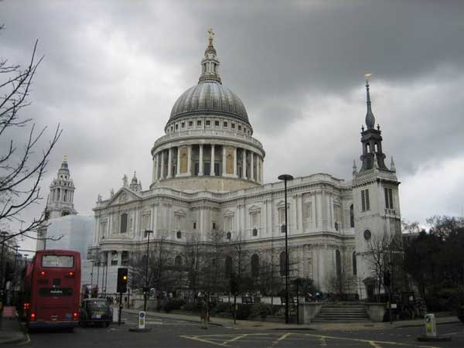
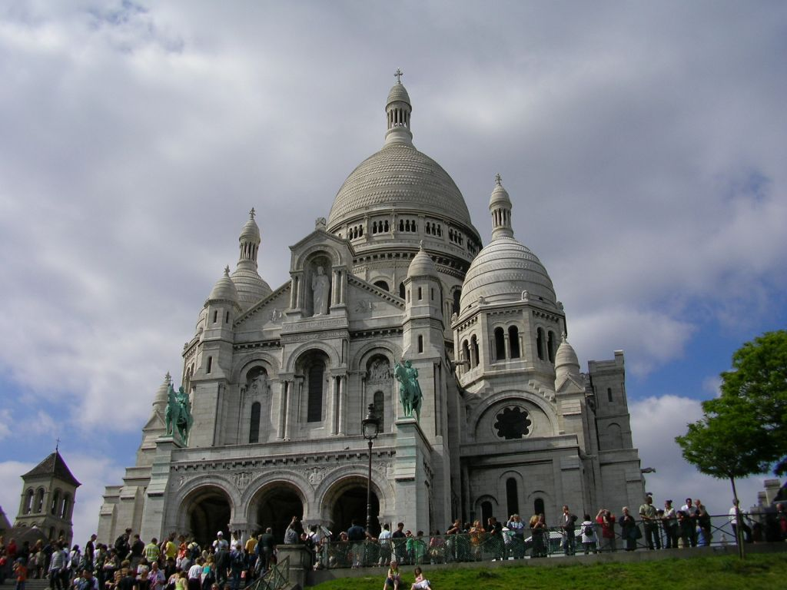
Gothic and Roman style in one.
St Paul's Cathedral
Basilique du Sacré-Cœur

Slide 19
Gothic and Roman style in one.
Was being built between 1675 and 1708.
Christopher Wren's project.
Significance for society: it’s the seat of the Bishop of London
Situated on Ludgate Hill, in the City of London.
Has two towers and one dome.
Overall dimensions:
Length: 180 meters,
Width: 30 meters,
Height: 108 meters.
Was being built between 1876 and 1910.
Abady’s project.
Significance for society: was built in memory of victims of Franco-Prussian War.
Situated at the summit of the butte Montmartre, the highest point in Paris.
Has one tower and five domes.
Overall dimensions:
Length: 85 meters,
Width: 35 meters,
Height: 83 meters.
St Paul's Cathedral
Basilique du Sacré-Cœur

Slide 20
Different from all.
Was being built between 1895 and 1903.
Was designed by John Francis Bentley.
Significance for society: the main and the largest Roman Catholic church in England and Wales
Situated in Victoria, in the City of Westminster.
Was being built between 1245 and 1248.
Was designed by Pierre from Montrei.
Significance for society: there were kept saint relics such as Christ’s Crown of Thorns.
Situated on the Île de la Cité in the heart of Paris.
Westminster Cathedral
Sainte-Chapelle

